Slide 1
Prophesy to these Bones

Slide 2
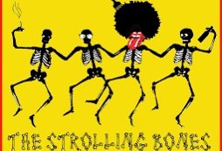

Slide 3

Ezekiel 37:1-10
37 The hand of the Lord was on me, and he brought me out by the Spirit of the Lord and set me in the middle of a valley; it was full of bones. 2 He led me back and forth among them, and I saw a great many bones on the floor of the valley, bones that were very dry. 3 He asked me, “Son of man, can these bones live?”
I said, “Sovereign Lord, you alone know.”
4 Then he said to me, “Prophesy to these bones and say to them, ‘Dry bones, hear the word of the Lord! 5 This is what the Sovereign Lord says to these bones: I will make breath[a] enter you, and you will come to life. 6 I will attach tendons to you and make flesh come upon you and cover you with skin; I will put breath in you, and you will come to life. Then you will know that I am the Lord.’”
7 So I prophesied as I was commanded. And as I was prophesying, there was a noise, a rattling sound, and the bones came together, bone to bone. 8 I looked, and tendons and flesh appeared on them and skin covered them, but there was no breath in them.
9 Then he said to me, “Prophesy to the breath; prophesy, son of man, and say to it, ‘This is what the Sovereign Lord says: Come, breath, from the four winds and breathe into these slain, that they may live.’” 10 So I prophesied as he commanded me, and breath entered them; they came to life and stood up on their feet—a vast army.

Slide 4
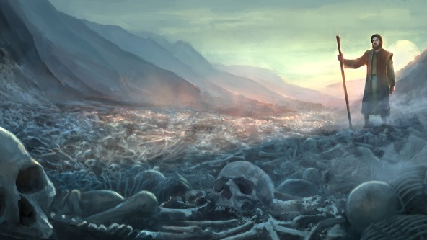

Slide 5
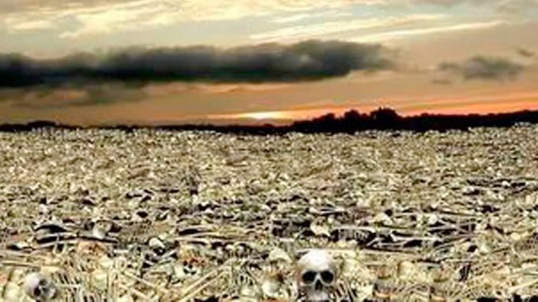

Slide 6
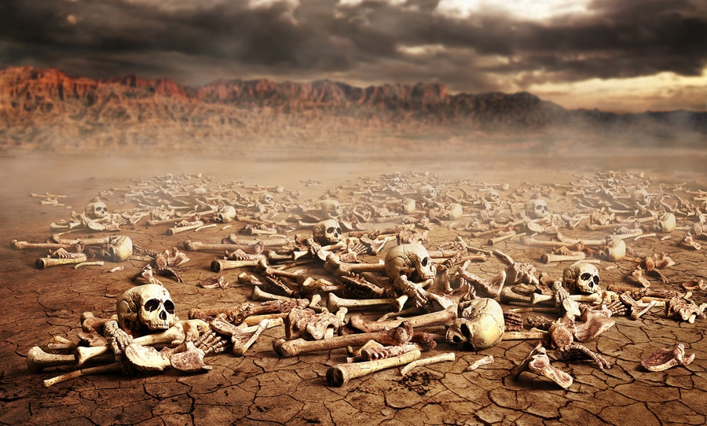

Slide 7
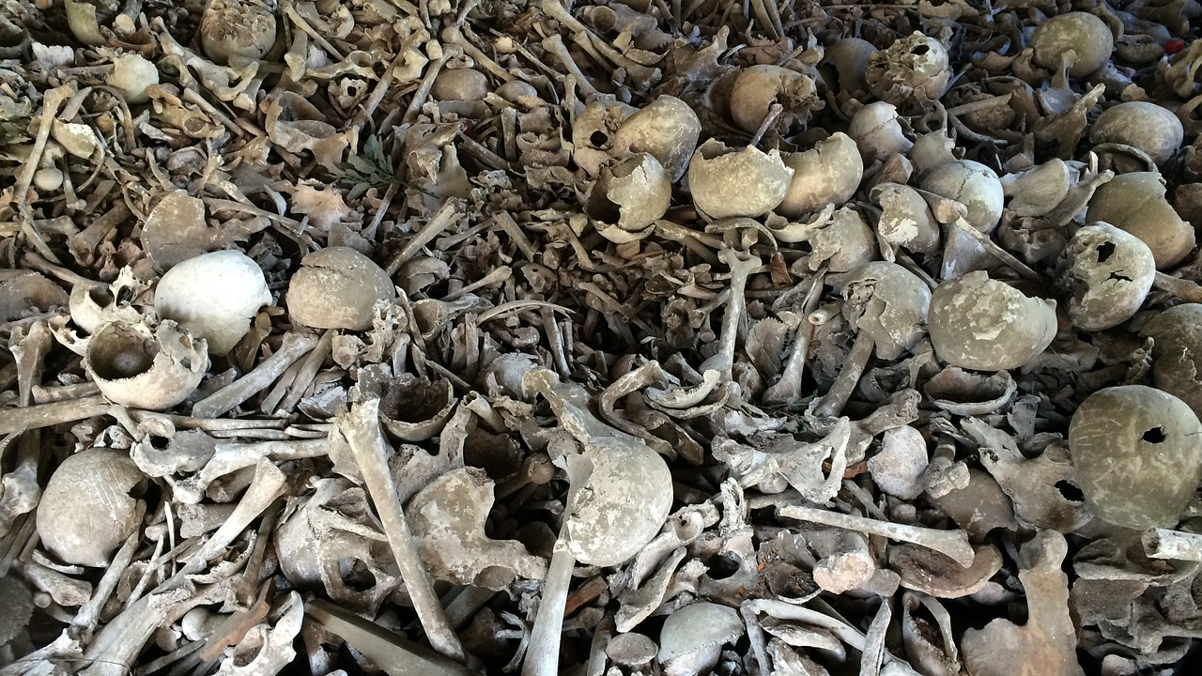

Slide 8
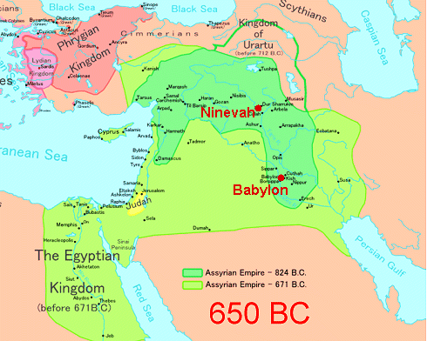

Slide 9
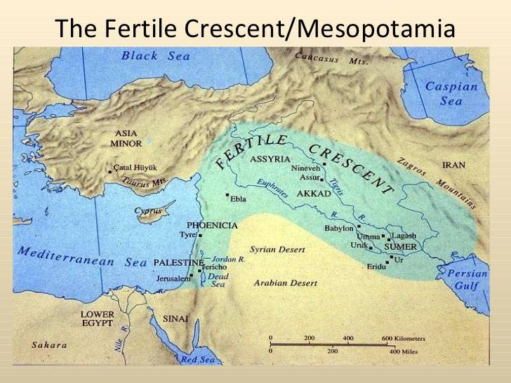

Slide 10
